Slide 1
Accessibility for the visualy impaired in space
Team members:
Avi Roshkovan
Daniel Dobkin
Michael Lackinger
Daniil Zaitsev

Slide 2
Our goal:
To help improve accessibility and independence for the visually impaired
To increase the accessible market for tourism companies
To help government and health institutions with supporting different populations with ease
To help space crew members whose eyesight got hurt in space

Slide 3
Caring has the gift of making the ordinary special
-George R. Bach

Slide 4
22,000,000 people
US $ 244 billion and US $ 25.4 billion.
The No. 1 health and safety problem
NASA declared vision – impairment the top priority to fix for space travel
Suffer from near or distance vision impairment.
Productivity cost lost from Myopia and presbyopia alone

Slide 5
Effects of vision loss in space
Lack of day/night cycles
Affects intracranial pressure and worsens eyesight. Astronaut John Phillips spent six months on the ISS. During his post-flight physical, NASA found that his vision had worsened significantly in just six months.
Loss of a crewmember
Hurts the chances of mission success, as burdens are shared across the crew. Allowing the injured some form of independence will enable the crew to keep up with tasks

Slide 6
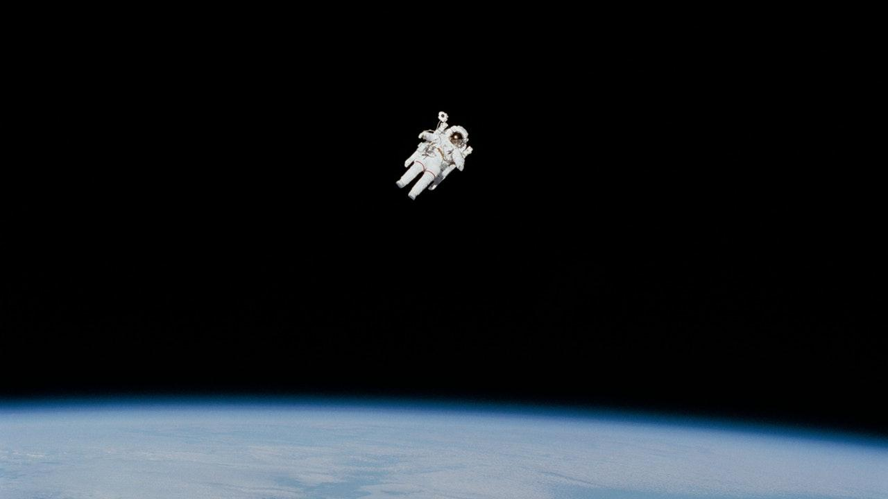

Slide 7
BUSINESS MODEL CANVAS
Key Partners
Insurance company's
Space tourism agencies
Government agency’s
Key Activities
Setup
Maintenance of units and servers
Continues model training and improvement
Value Propositions
Accessibility to new markets
Safety regulations
Ethics and public relations
Worker health
Customer Relationships
Website
Satellite phone
Customer Segments
Crew members
Visually impaired population
Key Resources
Computing server
Maintenance equipment and technicians
Backup units
Channels
Rent on site
Provided by employer
Loaned by different agencies and institutes
Ordered personally by client for his own environment
Cost Structure
Server upkeep
Technician training
Reserve parts and units
Tech support unit
Revenue Streams
Renting model
Maintenance model
Contract renewal and continuation benefits

Slide 8
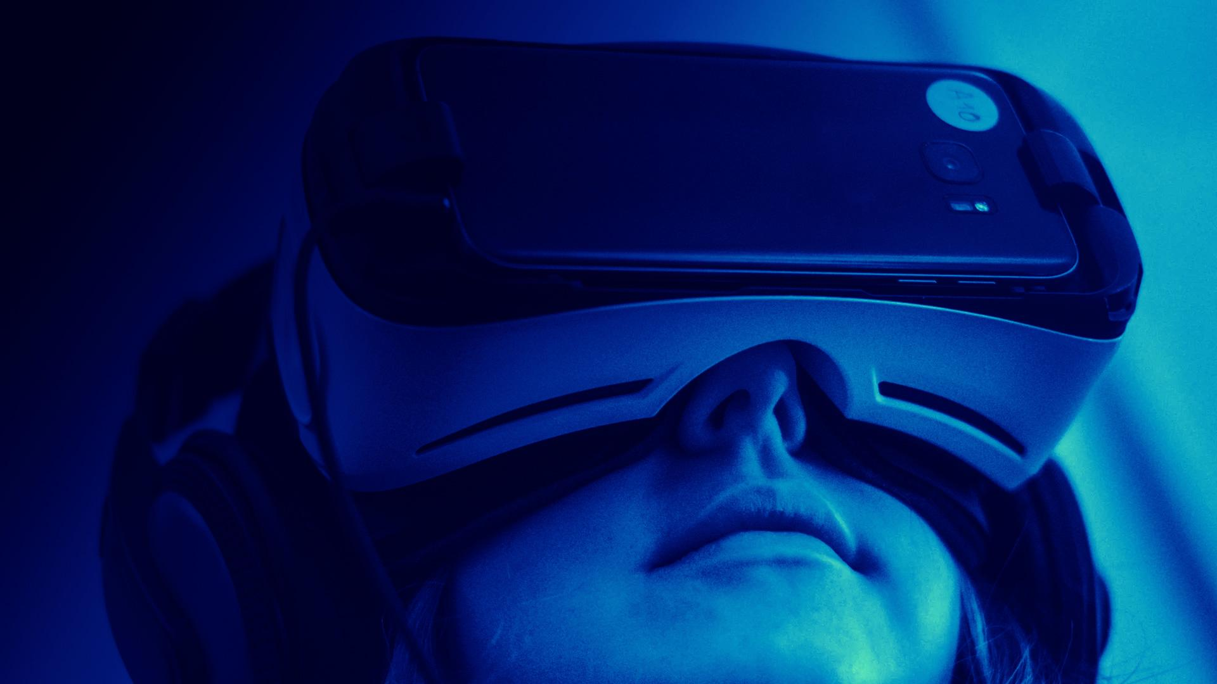
Our solution - ExoVision
We aim to apply deep learning models for speech and image recognition, in combination with an array of sensors and speakers worn by the subject and help them navigate throughout the immediate environment without assistance.

Slide 9
How it’s done
Artificial Intelligence
Training deep learning models for speech and image recognition on our systems and uploading them to the spaceship’s computer
Data
Is gathered by wearable glasses whos frame holds a camera, an ultrasonic sensor and a microphone .
Control
A module which consists of an arduino controller, power bank, joystick and a speaker allows for Wifi connectivity and physical inputs.
Computation
Power comes from the ship, which will run our trained models on it’s systems.
Information
Is given to the user using RGB led’s with a color coding and a speaker for additional sound que’s

Slide 10
Color coded instructions
Color
meaning
Green
Go forward, with color intensity changing how close you are to the target/next instruction
Red
Approaching an obstacle, with closer obstacles causing higher intensity
Orange
Approaching an obstacle to overcome, like a staircase, a door or a chair
Yellow
Turn to the left, changes upon next instruction
Blue
Turn to the right, changes upon next instruction

Slide 11
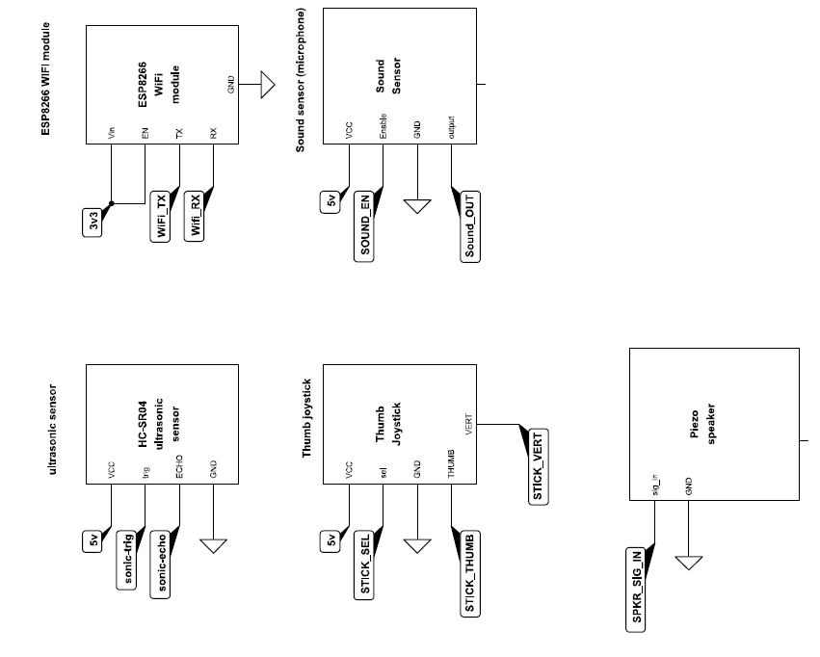
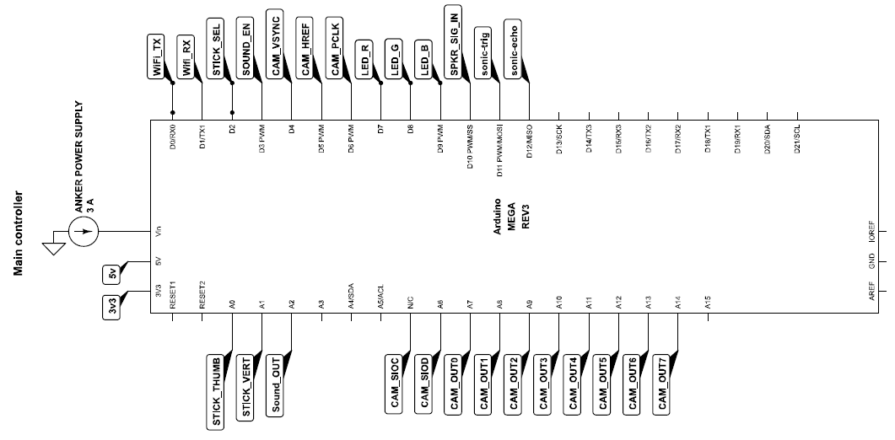
Electric schematics

Slide 12
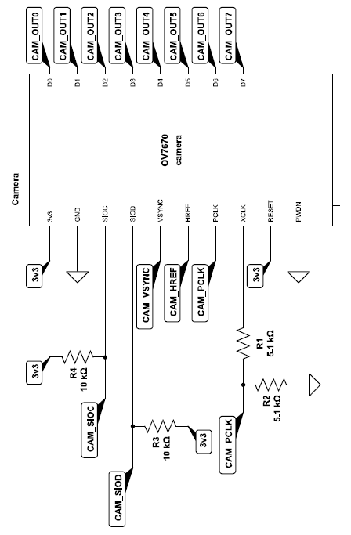
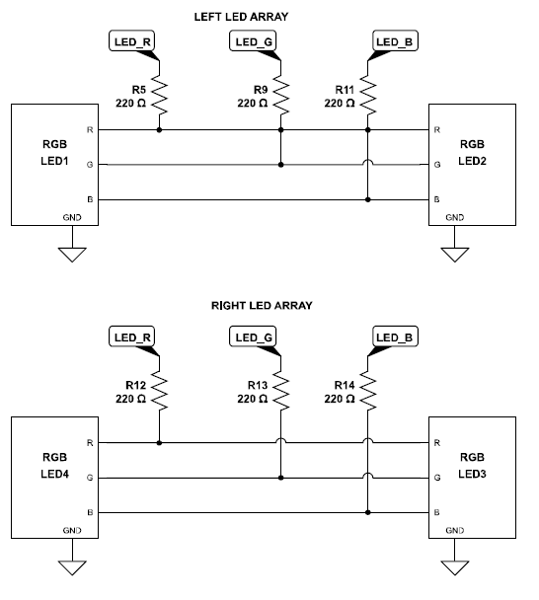
Electric schematics

Slide 13
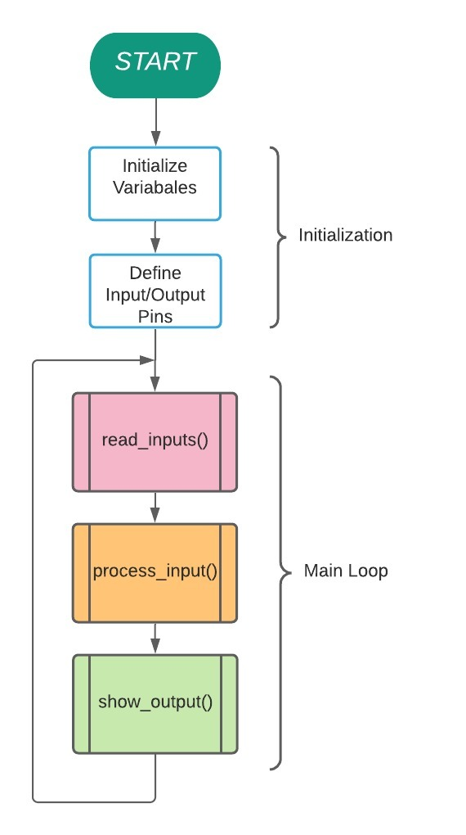
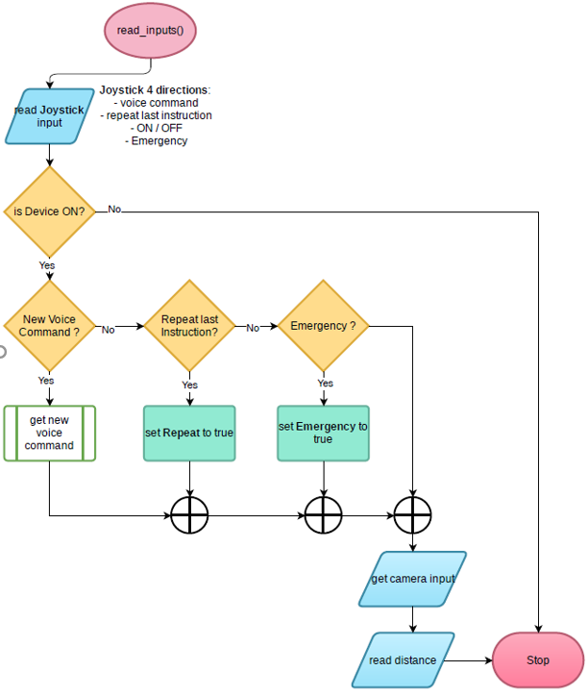
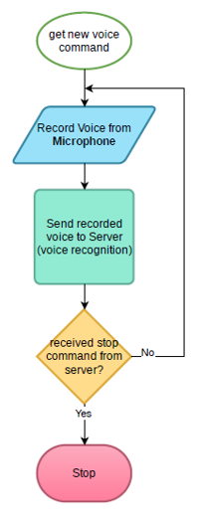
Algorithm flow chart diagram
Main program
Read inputs
New voice command

Slide 14
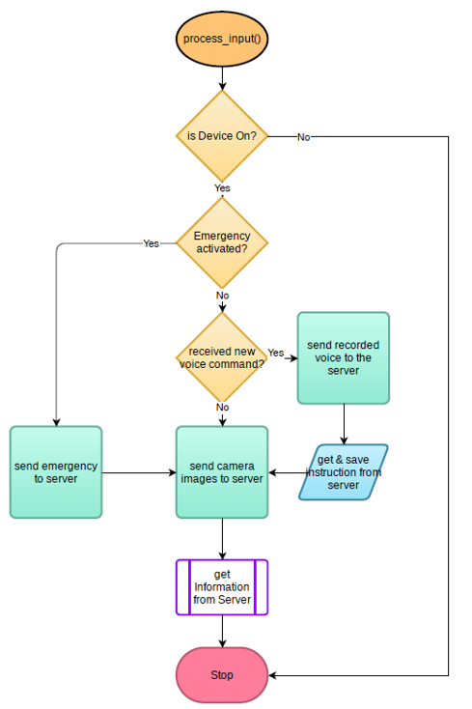
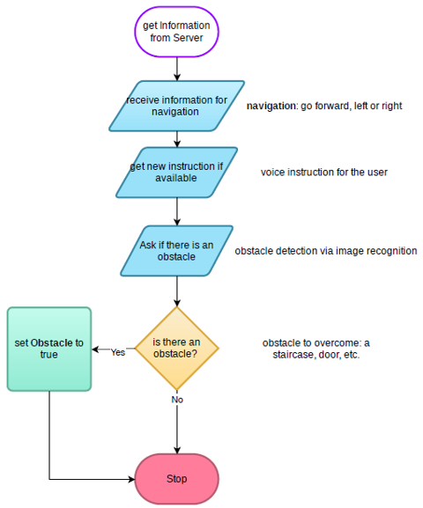
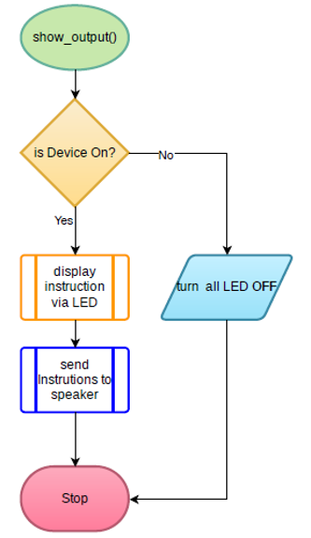
Algorithm flow chart diagram
Process input
Retrieving information
Instruction output

Slide 15
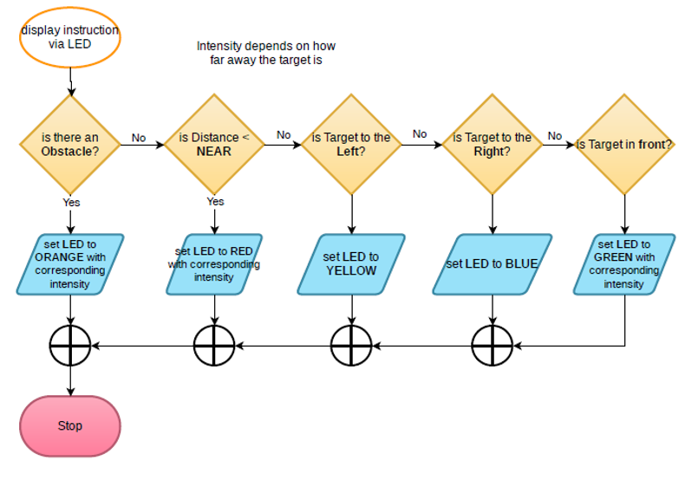
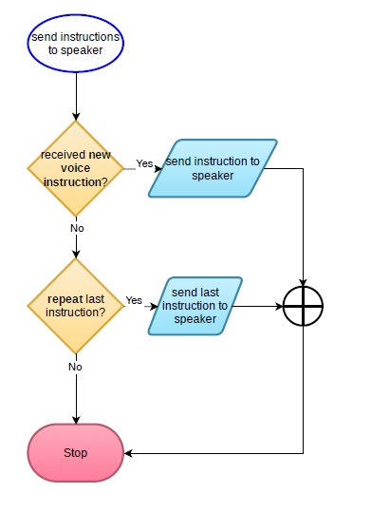
Algorithm flow chart diagram
LED instruction set
Speaker instruction set

Slide 16
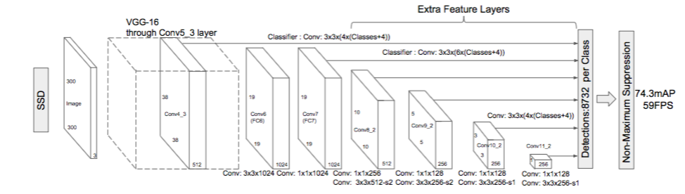
Object detection - SSD
Single shot
Multibox
Detector

Slide 17
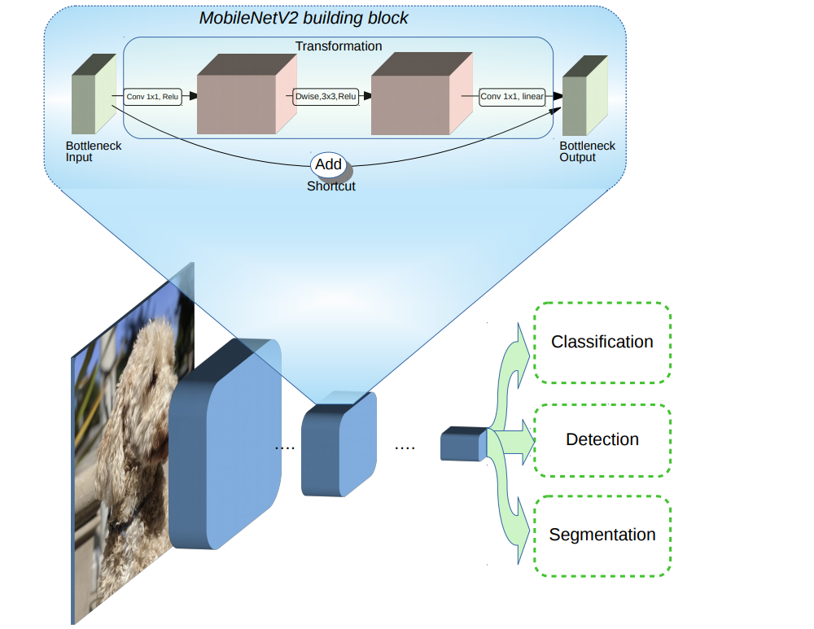
MobileNetV2

Slide 18
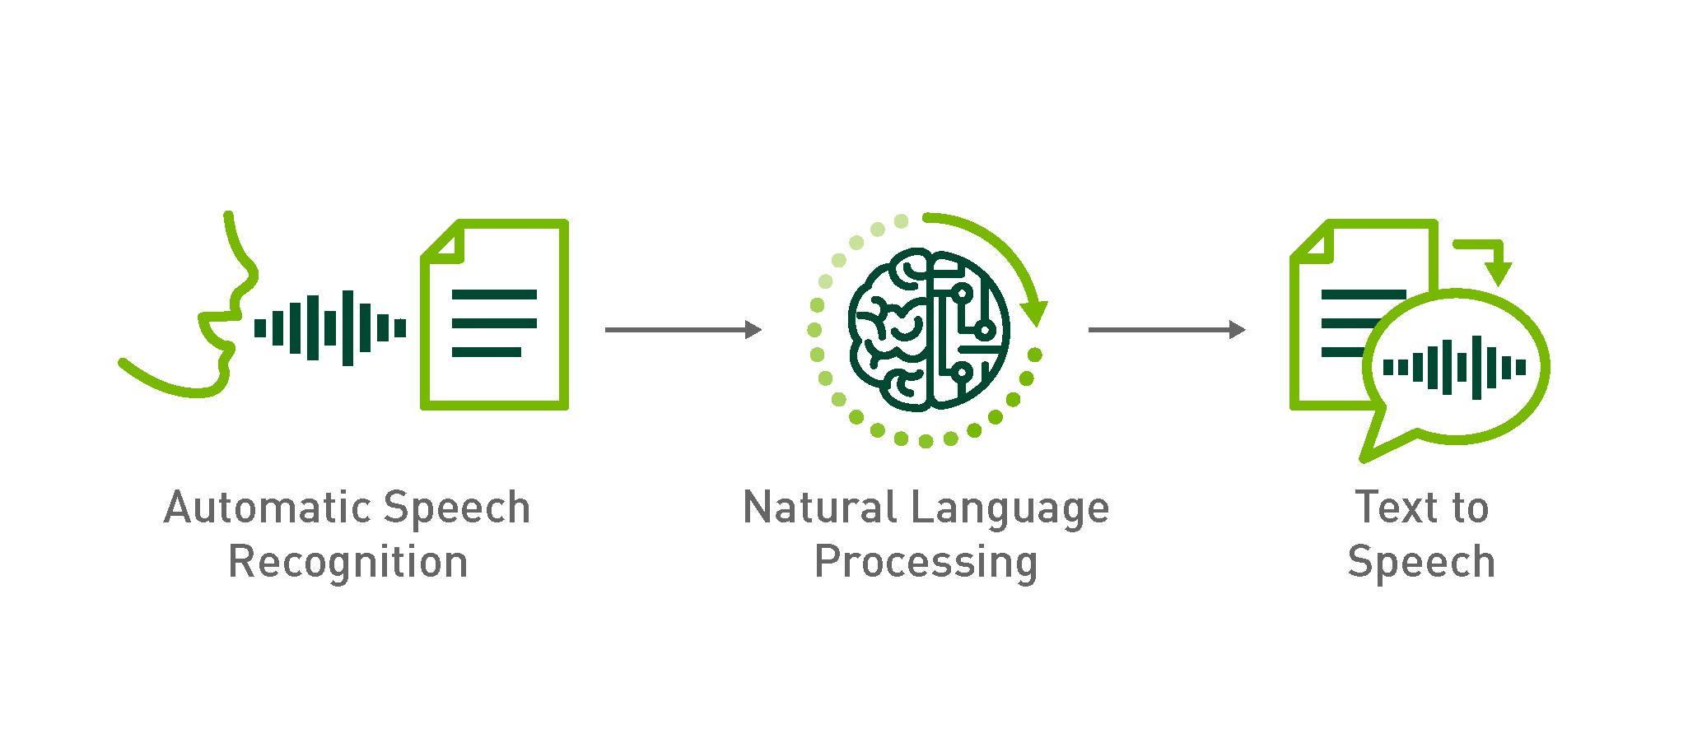
The process
A typical conversational AI application uses three subsystems to do the steps of processing and transcribing the audio, understanding (deriving meaning) of the question asked, generating the response (text) and speaking the response back to the human.

Slide 19

Speech recognition
ASR - the role of “listening” to what someone is saying. Stand for automatic speech recognition.
NLP - stands for Natural Language Processing
TTS – speech synthesis for communicating with the end user

Slide 20
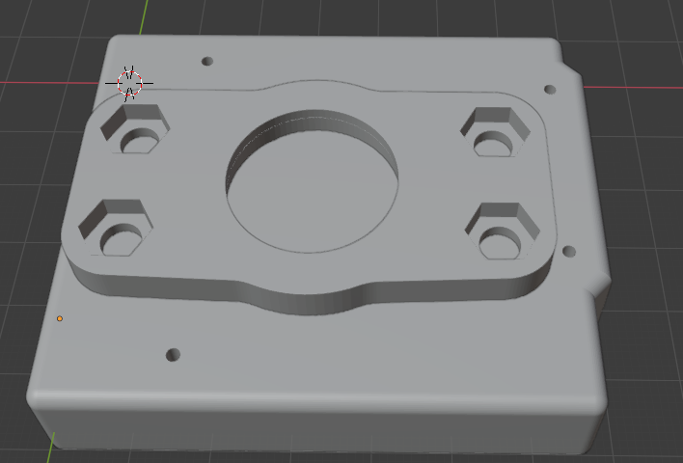
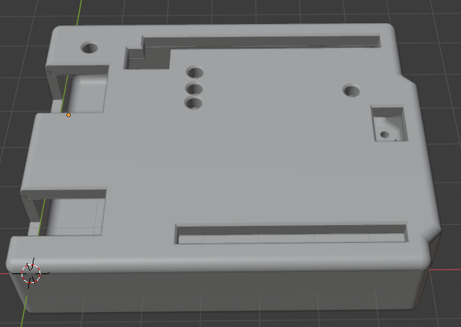
3D model – arduino case

Slide 21
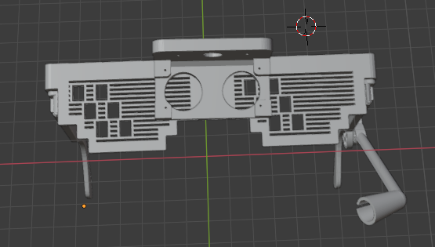
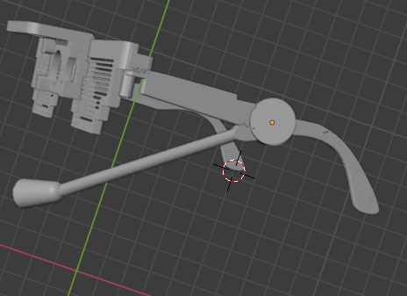
3D model – glasses

Slide 22
Invest in the future
In order to continue our work and design, we look for an investment of 1,000,000$ for 8% of company shares and the full commitment of our team of experts

Slide 23
THANKS!
Any questions?....
You can find us at
lackinger.michael@student.htlwrn.ac.at
Daniel.dobkin@live.biu.ac.il
aviro@my.hit.ac.il
roller12345@ukr.net

